Slide 1
Labelling and education

Slide 2
Watch this clip....
http://www.youtube.com/watch?v=a_MyAs4t5Z8
How does this link to education??

Slide 3
Lesson question
labelling affects how well we do in school?
Agree or disagree?

Slide 4
Starter
There are a number of pictures around, visit each picture and write one word on each picture that you think matches.
You cannot write the same word as someone else.

Slide 5
Lesson Overview
To understand what labelling is
To analyse the different studies on labelling within education
To evaluate the consequences of labelling
C/ Fully complete the labelling worksheet.
B/ Be able to explain at least two key labelling theories.
A/ Reaching the higher band within the 12 mark question.
Groupings of students are based upon individual skill and knowledge level for that task
VCOP’s are personalised to ensure they assist students in exactly the way required.
Dictionaries
VCOP
Thesaurus
Students throughout will question labelling. Is it right or wrong? What impact it has on an individual within education?
Has labelling affected you if so how?
What do I need to learn? To understand what labelling is. To analyse the different studies on labelling within education To evaluate the consequences of labelling. How am I going to achieve it? C/ Fully complete the labelling worksheet. B/ Be able to explain at least two key labelling theories. A/ Reaching the higher band within the 12 mark question.

Slide 6
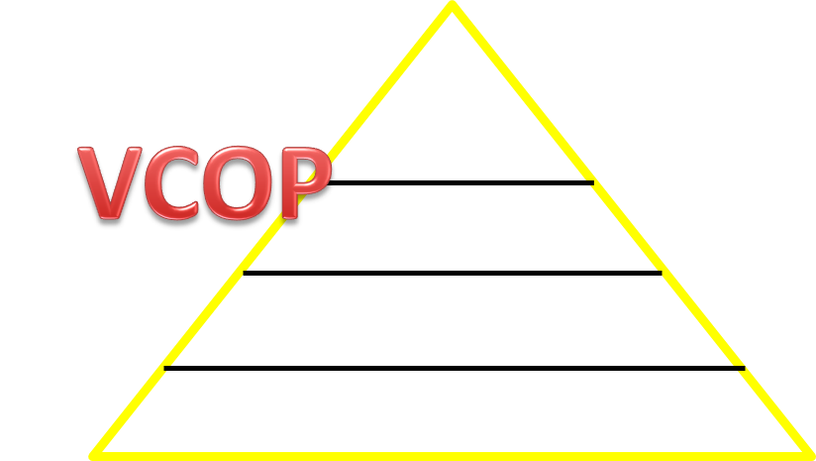
Key words
Labelling
Self fulfilling prophecy
Halo effect
Rebellion
Retreatism
Ritualism
Expectations
Stereotype
Non-conformist delinquents
Add the words you do not know to your VCOP,
hopefully we can cross it off by the end of the lesson!

Slide 7
Labelling theory
To attach a meaning or definition to a student, e.g. They’re thick, smart, hardworking
Some pupils are labelled positively, others negatively

Slide 8
But...
Self refuting prophecy= some pupils try to detach themselves from the label and prove the teacher wrong!
What would the key theorists think of labelling?

Slide 9
Activity one
Complete the Labelling worksheet.
What do I need to learn? To understand what labelling is. To analyse the different studies on labelling within education To evaluate the consequences of labelling. How am I going to achieve it? C/ Fully complete the labelling worksheet. B/ Be able to explain at least two key labelling theories. A/ Reaching the higher band within the 12 mark question.

Slide 10
Speed dating
You will be given a piece of sociological research related to labelling.
You have 3 minutes to memorise the study, you are then able to summarise the study into 5 words ready for you to explain the study to other students.
What do I need to learn? To understand what labelling is. To analyse the different studies on labelling within education To evaluate the consequences of labelling. How am I going to achieve it? C/ Fully complete the labelling worksheet. B/ Be able to explain at least two key labelling theories. A/ Reaching the higher band within the 12 mark question.

Slide 11
Exam question
c) Outline some of the ways in which the labelling process may lead to educational under-achievement for some pupils.
P-oint
E-xplain
E-vidence
L-ink
12 minutes to answer the question
Swap over and mark each others using the PEEL structure and the Mark scheme

Slide 12
Lesson question
labelling affects how well we do in school?
Agree or disagree?
What do I need to learn? To understand what labelling is. To analyse the different studies on labelling within education To evaluate the consequences of labelling. How am I going to achieve it? C/ Fully complete the labelling worksheet. B/ Be able to explain at least two key labelling theories. A/ Reaching the higher band within the 12 mark question.

