Slide 1
Lesson Overview
Confidently categorise NSM’s and OSM’s using complex and politically subjective information.
Explain the attributes of direct action and its impact on the political process.
Critically analyse the role of the media in the political process, leading to identity politics.
A- Consider all elements of information provided about SM’s and confidently categorise, with justification, their position in society with context and application of previous sociological theory such as consumption cleavages and counterculture. Apply knowledge of direct action, applying the media as a political catalyst.
B- Categorise with reasons SM’s. Explain how direct action impacts society and the political process. Define the role of new media mediums.
All tasks throughout the lesson are differentiated. Groupings of students are based upon individual skill and knowledge level for that task, see individual task slides. Grade A students are used as an advisor and SMSC link in groupings.
VCOP’s are personalised to ensure they assist students in exactly the way required.
A grade students access Collins for AQA material as starting point, B grade students use CGP material as starting point for information.
All students have access to Sociological dictionary.
Key Terms: Direct Action, Strikes, Riots, Identity politics, cultural effects theory, sues and gratification model, two step flow model.
Should we have a centrally controlled media?
What direct action is currently occurring in society?
Do you need to join a SM to participate in direct action?

Slide 2
VCOP

Slide 3
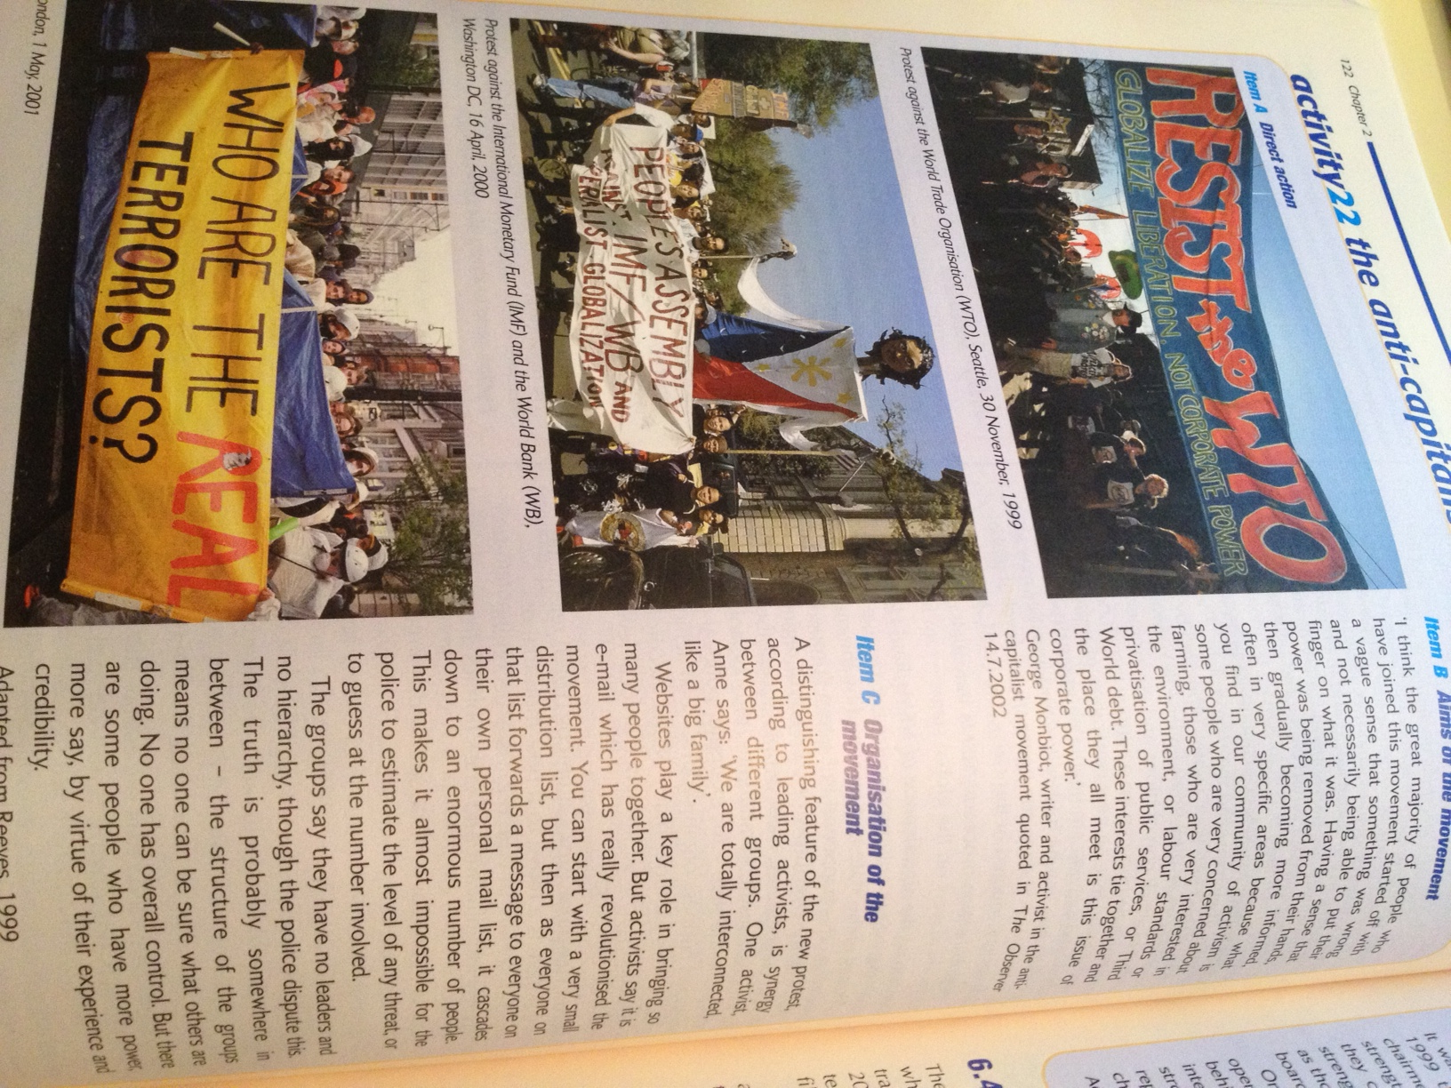

Slide 4
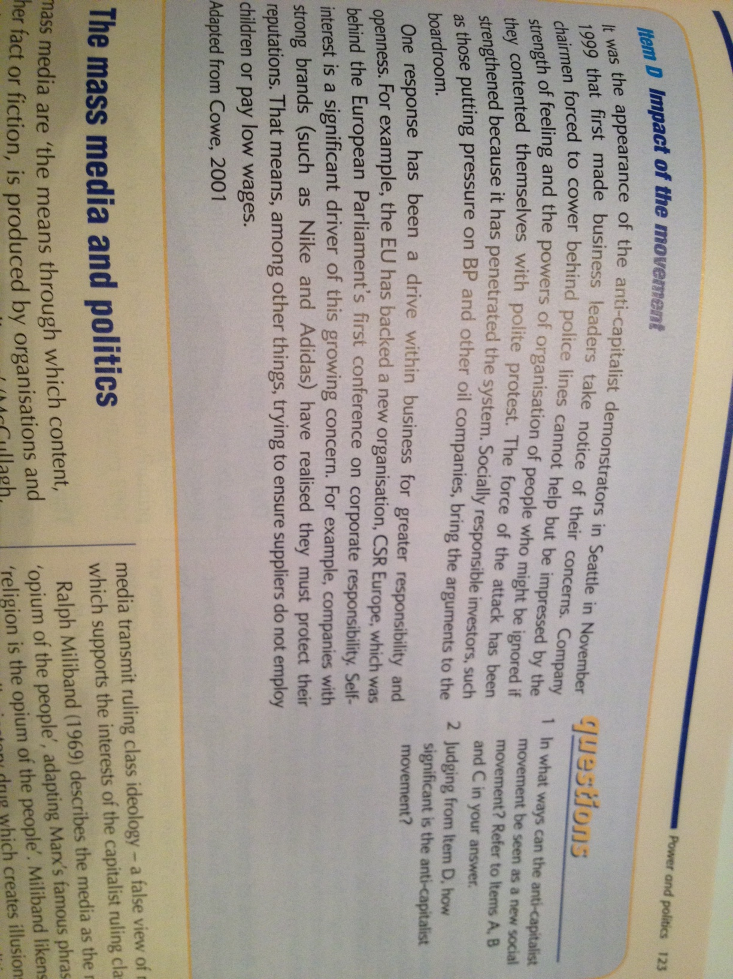

Slide 5
Riots and Strikes
Similarities (Neelam, Lauren, James) | Differences (Sam, Abi, Nicola)

Slide 6
Is direct action morally right?
Sam, Abi, Lauren build an
Argument saying “no”
Neelam, Nicola and James
Build an argument saying
“yes”
Each make at least 6 points

Slide 7
What is the role of the media in the political process?
Abi and Lauren
The two step flow model
Sam and Nicola
The Uses and Gratification model
James and Neelam
Cultural effects theory
Abi, Nicola, Sam-P- Evaluate- 2 pro’s, 2 con’s.
Lauren, Neelam, James- O- Explain- 5 points
Combine your answers to discover the answer

Slide 8
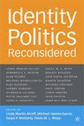
Check this book
out online and
write a review
on our website
under the blog
section

Slide 9
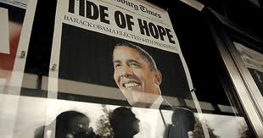
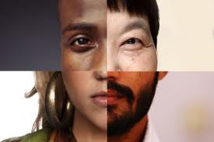
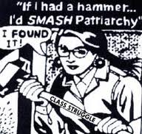
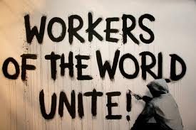
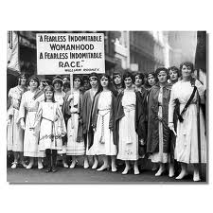
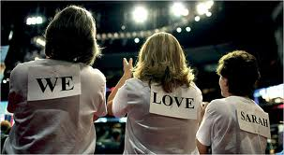
Using these pictures below and the knowledge gained from
Reading the above book…
1) Define identity politics
2) Explain how identity politics has
changed over the last 10 years.

Slide 10
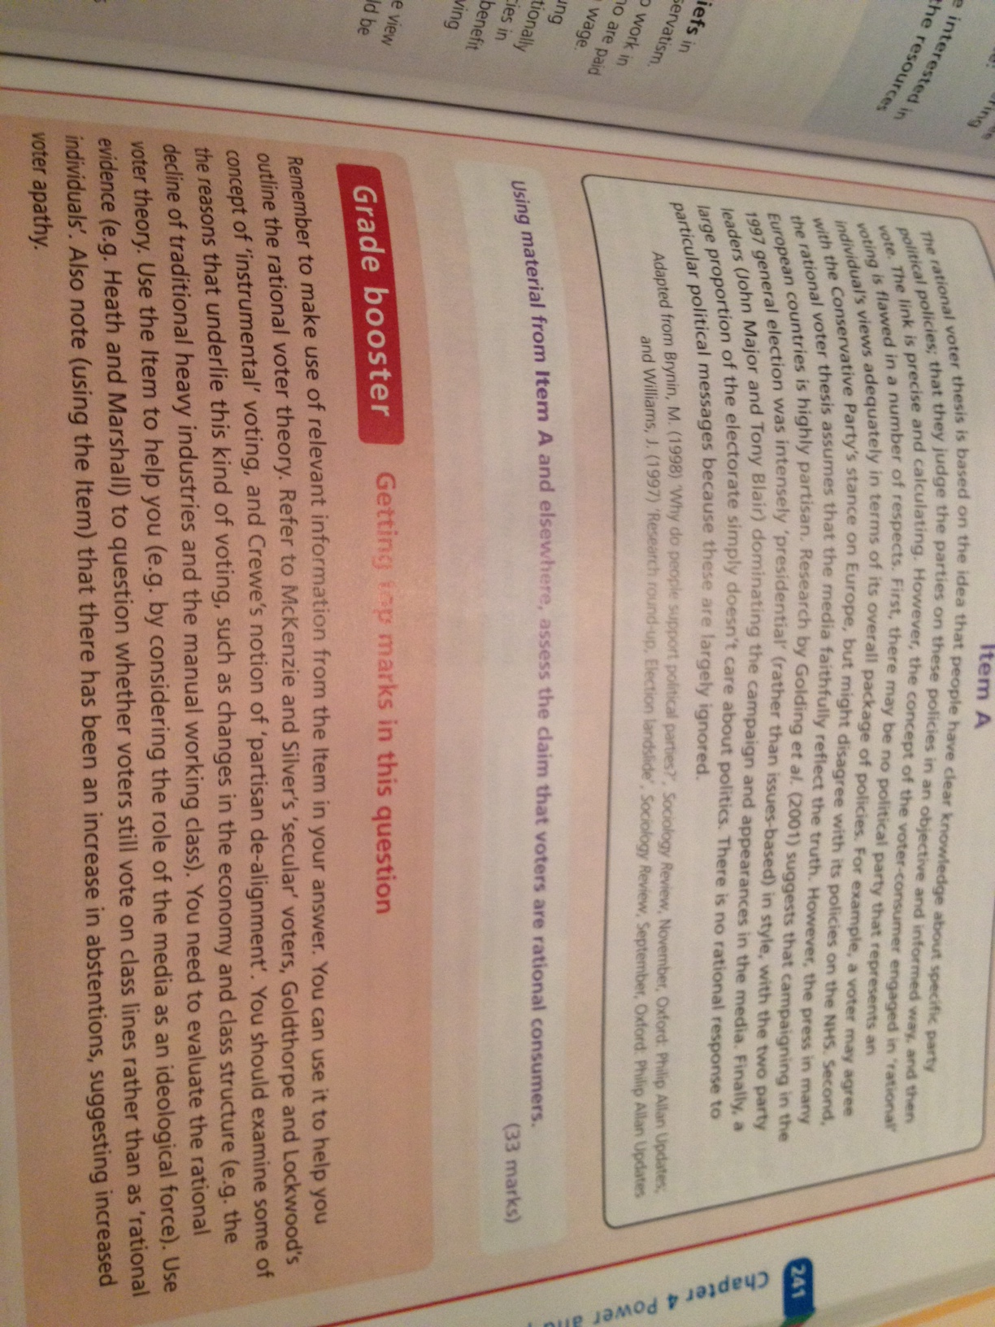
Complete this question due 11/12/12

Slide 11
Objectives
1. Confidently categorise NSM’s and OSM’s using complex and politically subjective information
2. Explain the attributes of direct action and its impact on the political process.
3. Critically analyse the role of the media in the political process, leading to identity politics.

