Slide 1
Lesson Overview
1.Contextually explain the factors that affect voting behaviour in the UK
2.Understand consumption cleavages and how they potentially link to social class.
3. Define voter apathy and discuss a potential link with voter turnout
A Grade- Understand and explain that a large variety of societal factors contribute to voting behaviour, appreciating their synoptic links. Demonstrate that consumption cleavages can be attributed to social class, if indeed it is accepted that a concept exists. Illustrate, with examples, that voter apathy exists in the UK and may be one of many factors attributed to voter turnout.
B Grade- Understand that a number of factors contribute to voting behaviour. Show how consumption cleavages can link to social class. Demonstrate that voter apathy and voter turnout link.
All tasks throughout the lesson are differentiated. Groupings of students are based upon individual skill and knowledge level for that task. Grade A students are used as an advisor and SMSC link in groupings.
VCOP’s are personalised to ensure they assist students in exactly the way required.
A grade students access Collins for AQA material as starting point, B grade students use CGP material as starting point for information.
All students have access to Sociological dictionary.
Key Terms: Consumption Cleavage, Voter apathy, Voter turnout, instrumental voters, political literacy, tactical voting
Key People: Joseph Rowntree, Campbell and Winters (2008), White (200)
VCOP use throughout lesson.
Students work in differentiated groups to encourage student led learning. No teacher questioning, only students questioning allowed.
Students debate the categorisation of people within society. Does Social class exist? Are we all middle class?

Slide 2
Starter
James, Abi, Neelam
Voter apathy
Media
This link has occurred because…
Factors affecting
voting behaviour
1997 onwards
1.Explain voting behaviour in the UK 2.Understand consumption cleavages, how they link to social class. 3. Link voter apathy with turnout

Slide 3
Starter
Lauren, Sam, Nicola
Factors affecting
voting behaviour
1979-1997 onwards
1.Explain voting behaviour in the UK 2.Understand consumption cleavages, how they link to social class. 3. Link voter apathy with turnout

Slide 4
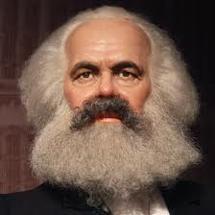
Test your knowledge…
VCOP!
Nicola, Sam, Abi
Identify and explain why membership
of the three largest political parties has declined
the last 30 years. (9 marks)
James, Neelam, Lauren
Identify and explain how voting behaviour changed from 1997 onwards. (9 marks)
1.Explain voting behaviour in the UK 2.Understand consumption cleavages, how they link to social class. 3. Link voter apathy with turnout

Slide 5
Big questions…
How do consumption cleavages
affect voting behaviour?
Do they link to Social class?
1.Explain voting behaviour in the UK 2.Understand consumption cleavages, how they link to social class. 3. Link voter apathy with turnout

Slide 6
Abi, Nicola, Sam | Lauren, James, Neelam
1. Create a definition of “cleavage” for the class to understand. | 1. Create a definition of “consumption” for the class to understand.
Come together and create a definition for consumption cleavages
Abi, Nicola, James | Lauren, Sam, Neelam
2. Does gender affect your consumption cleavage? | 2. Does occupation affect your consumption cleavage?
Come together and decide which factors affect your CC
Neelam, Nicola, James | Lauren, Sam, Abi
2. Provide a judgement, with evidence, about whether Social Class and CC link. | 2. Provide a judgement, with evidence, about whether Social Class and CC link.

Slide 7
Come together and create a 100 word explanation of your class decision, with evidence.
SMSC
Are there any other ways we could categorise people in society when discussion voting behaviour? E.g. use of social media?
1.Explain voting behaviour in the UK 2.Understand consumption cleavages, how they link to social class. 3. Link voter apathy with turnout

Slide 8
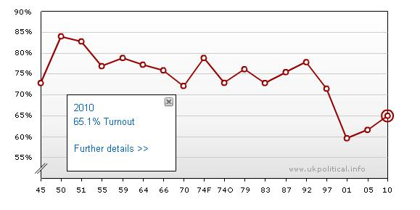
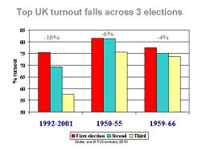
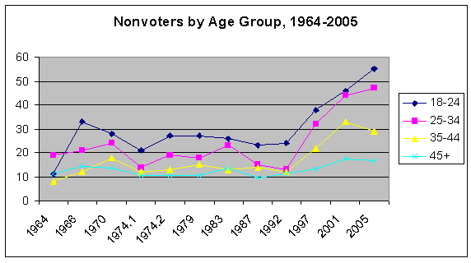
Lauren, Nicola, Abi
A. Create a statement about RECENT voter participation in the UK
B. Identify KEY TRENDS in voter turnout over the past 50 years
C. Explain recent participation
rates linking factors that affect voting behaviour
Do you need info from the other group??

Slide 9
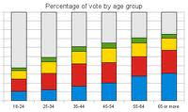
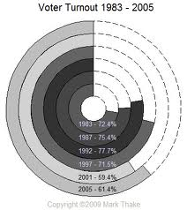
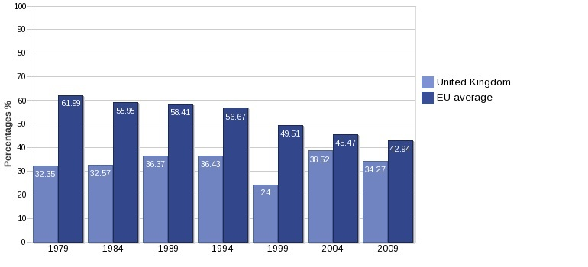
Sam, Neelam, James
A. When did voter apathy begin in the UK?
B. Identify KEY TRENDS in voter turnout over the past 50 years
C. How does voter turnout link to voter apathy and voting behavioural factors?

Slide 10
Test your knowledge…
Exam Q…33 Marks!!
VCOP!
Sam, James, Abi | Lauren, Neelm, Nicola
Voter apathy is merely a reflection of globalisation, discuss | Voter turnout is linked entirely and only with voter apathy, dicuss.
Introduction
(use question wording)
Paragraph 1
(view 1 with evidence)
Paragraph 2 (view 2 with evidence, direct comparison with view 1
Paragraph 3
(view 3 with evidence, compare with view 1&2)
Paragraph 4 (contemporary view linked to news story or your view- new ways of categorising people??
Conclusion
(directly answer the question, provide brief summary of views, thought provoking!)
SMSC
1.Explain voting behaviour in the UK 2.Understand consumption cleavages, how they link to social class. 3. Link voter apathy with turnout

Slide 11
http://www.educationforum.co.uk/sociology_2/powerinvaders.htm
http://www.educationforum.co.uk/sociology_2/revisionquiz4.htm
Objectives
1. Contextually explain the factors that affect voting behaviour in the UK
2. Understand consumption cleavages and how they potentially link to social class.
3. Define voter apathy and discuss a potential link with voter turnout

Slide 12
Hand in your homework
H/W:Describe and explain how
Interlinking factors affect
Voring behaviour
What happened between 2005-2001?

