Slide 1
Lesson Overview
Understand the impact of Media messages on voting behaviour
Compare and contrast the views of New and Old Social Movements
Understand the difference between Old, New Social Movements and pressure groups (outsider and insider)
A Grade- Understand and explain that the media can be politically motivated and that people with poor political socialisation can be heavily influenced by its messages. This can be viewed positively or negatively. Explain that New and Old social movements are intrinsically different but can, at times, join in cause. Illustrate the changing picture of the political climate and the affect on SM’s.
B Grade- Understand that the media can heavily affect voting behaviour, not always in the way politicians wish, providing examples. Produce a timeline of social Movements, explaining how old social movements appear to have lost popularity.
All tasks throughout the lesson are differentiated. Groupings of students are based upon individual skill and knowledge level for that task, see individual task slides. Grade A students are used as an advisor and SMSC link in groupings.
VCOP’s are personalised to ensure they assist students in exactly the way required.
A grade students access Collins for AQA material as starting point, B grade students use CGP material as starting point for information.
All students have access to Sociological dictionary.
Key Terms: New Social Movement, Old social Movement, Pressure group, Insider, outsider, offensive, defensive.
Key people: Hallsworth (1994) , Habermas (1979), Klein (2001)
Big question- Do OSM’s, NSM’s and pressure groups help or inhibit democracy? Moral debate.
Does access to media link with culture?
Do OSM’s have a place in the spiritual world?
Group work, whole class debate and group presentations.

Slide 2
VCOP

Slide 3
Starter
A Grade
Produce an argument for
the House of Commons
stating that the Voting age
should NOT be dropped. You must provide at least 3 pieces of evidence, one must include the EU
B Grade
Produce an argument for the House of Commons stating that the voting age SHOULD be dropped. You must provide 3 pieces of evidence, one must include Social Media.

Slide 4
Neelam/Lauren- How many types of media
are there in this picture? Do they link?
Sam/Abi-How many
types of social media exist?
GUMG view on social media?
James/Nicola-How many of sections
of the media would a person
interact with in a day? Explain how…

Slide 5
Blue Team- Lauren, Abi, Sam
1.Who is this man?
2. What is meant by the phrase?
3.Explain why this man would be looked at in the topic of media?

Slide 6
Green team- Nicola, Neelam, James
1.What does this headline refer to?
2. What did this event mean for the media?
3.How has the status of newspapers changed over the last ten years? Why?

Slide 7
Pair and Share then answer the exam q
Abi+James
Nicola+Lauren
Sam+Neelam
Identify and explain why some sociologists would
argue that the media has an increasingly
significant influence on voting
behaviour in society today (9 marks)

Slide 8
Staying in your pairs…
Look at the two slides below…
What do the two movements have in common?
How do they differ?
Are they the same type of movement?

Slide 9
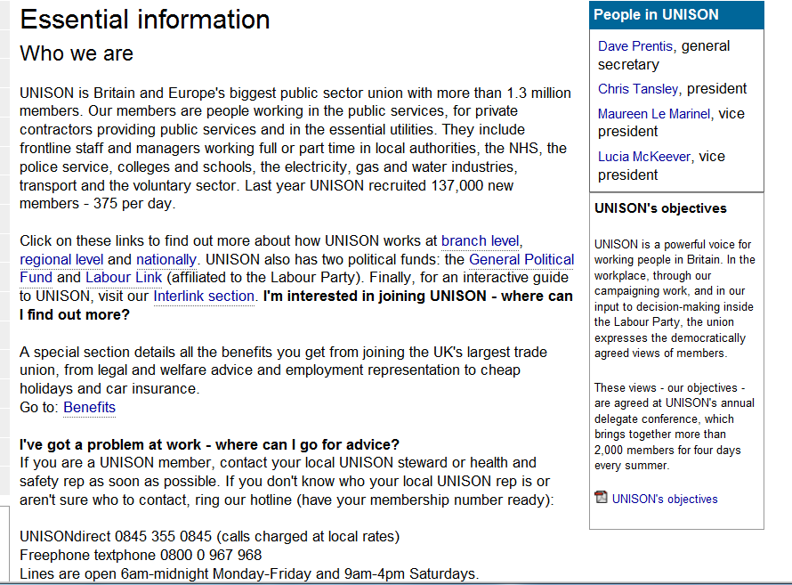

Slide 10
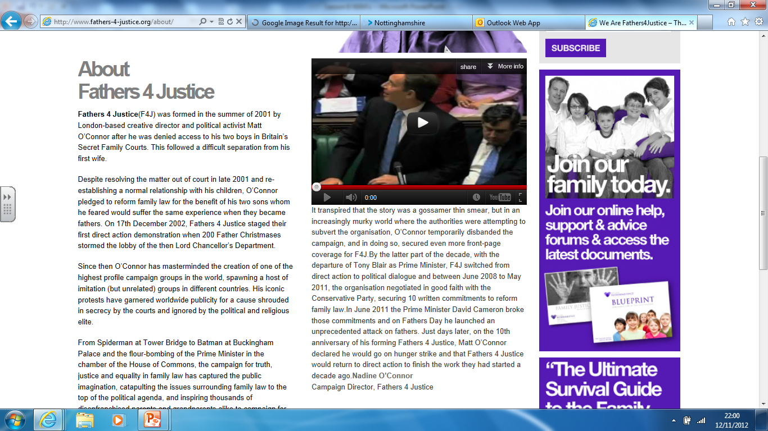

Slide 11
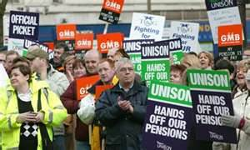
Old Social Movements-
complete the table
Characteristics | OSM-Labour movement
Principal Objective
Types of movement
Key Issues
Organisation
Tactics
Link to international
Main social base

Slide 12
HELP!!
If you find the table too hard you will
be directed to this slide…
What do they want they achieve?
Linked to politics or culture?
How do people in the group communicate?
What do they do to achieve their goal?
Which social class is most likely to join?

Slide 13
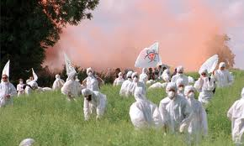
http://www.bbc.co.uk/learningzone/clips/pressure-groups/5620.html
New Social Movements-
complete the table
Characteristics | OSM-Labour movement
Principal Objective | You will be directed to use the help slide if you struggle…
Types of movement
Key Issues
Organisation
Tactics
Link to international
Main social base

Slide 14
Blue team
You must create 3 paragraphs that
link all of the words in the diagram
together. It must provide an A grade
Explanation of each word integrated within it
Green team
Provide a definition of each of the words
in the diagram. Which pairs of words
may link together?

Slide 15
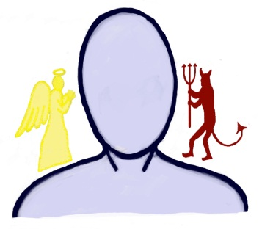
OSM
NSM
Pressure Group
Outsider
Defensive
Insider
Offensive
Global social movements

Slide 16
Securing our knowledge and
plenary tasks

Slide 17
Create your own…
Blue team
Create an offensive NSM, you must be able to
Full fill the seven elements from our previous table
Green team
Create a traditional OSM, you must be able to
Full fill the seven elements from our previous table
Present to the class- who will have the most
Members by the
end of the lesson??

Slide 18
Big Question…
Do NSM’s, OSM’s and Pressure
groups help or inhibit democracy?

Slide 19
Students who originally knew none of the answers, after filling in one or two of the answers become a resource for others because they have become "someone who knows.”
Questions – Find someone who...
1. Can explain the difference between the Marxist theory of the distribution of
power in society and elite theory
2. Can define ‘the state’
3. Give 6 factors which may influence voting behaviour
4. Can name the political ideologies associated with the 3 main political parties
5. Knows the difference between ‘left wing and right wing’ ideas and can give 2
ideas as examples
6. Can explain the pluralist view of the role of the state and give an example of a
pluralist theorist
7. Can define globalisation
8. Can explain the difference between old politics and new politics
9. Can explain what an NSM is and how it is different from a pressure group
10. Can give you an understandable definition of postmodernism

Slide 20
Objectives
1.Understand the impact of Media messages on voting behaviour
2. Compare and contrast the views of New and Old Social Movements
3. Understand the difference between Old, New Social Movements and pressure groups (outsider and insider)

