Slide 1
Lesson Overview
Understand why young people may increasingly access politics through NSM’s.
Describe the connection between NSM’s and Postmodernism
Explain how societies members may take direct action outside of the political process.
A Grade- Illustrate that young people appear to increasingly access politics through NSM’s, provide a detailed hypothesis of why this could be. Show that many sociological theorists believe the link between NSMs and PM to be strong. Contrast political processes which are inside and outside of the “normal” political process.
B Grade-Explain why NSM participation has risen amongst young people, showing that NSM’s have some links to PM. Show that you understand that some people chose to take part in politics but in not in a socially acceptable way.
All tasks throughout the lesson are differentiated. Groupings of students are based upon individual skill and knowledge level for that task, see individual task slides. Grade A students are used as an advisor and SMSC link in groupings.
VCOP’s are personalised to ensure they assist students in exactly the way required.
A grade students access Collins for AQA material as starting point, B grade students use CGP material as starting point for information.
All students have access to Sociological dictionary.
Key Terms: Alienation, counterculture, deformed polyarchy, Global branding, Hyperpluralism, polyarchal democracy, Klein (2001) Benyon (1987), Faulks (1999)
Big question-Should young people be encouraged to join NSMs to increase political participation?
Does state politics really matter at all in the new global arena?
Have young people lost their identity in the Postmodern world

Slide 2
VCOP

Slide 3
Objective 1
Starter
B grade-Using your prior knowledge and
the table, state whether the following
are NSM’s or OSM’s.
Consider offensive/defensive positions
A Grade-Provide evidence to support your view
which includes the name of at least one
sociologist

Slide 5
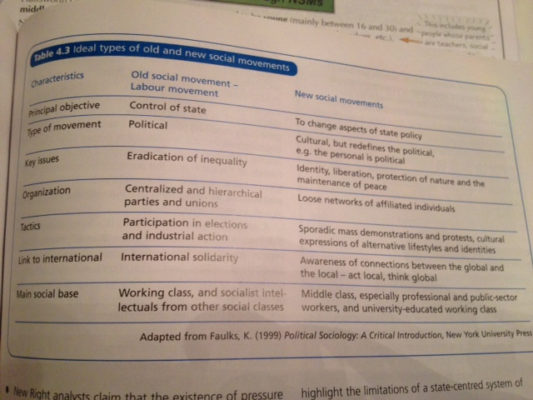

Slide 6
Read the information attached
Is it describing an NSM or OSM?
Why? B grade
Can you create a description for
The opposite SM? A Grade

Slide 7
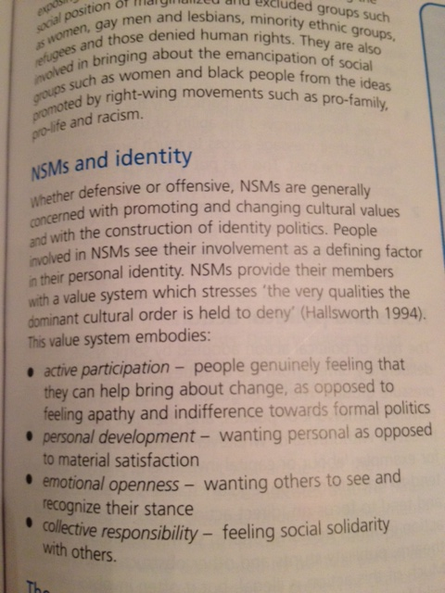
Objective 1

Slide 8
Class vote…
Which SM would you prefer to join?
A grade- Provide 3 reasons with context
such as consumption cleavages
B Grade-provide 3 reasons with clear
Explanations such as Social class alignment

Slide 9
Check your knowledge…
Describe and explain how young
people most frequently
access politics in society
today (9 AO1 marks)

Slide 10
Objective 2
Group F | Group P
Nicola | Abi
Sam | Neelam
James | Lauren
1. Create a definition of modernity | 1. Create a definition of postmodernity
2. Discuss the view that sociocultural divisions are more important that socioeconomic divisions (Crook et al 1992)- how does this link to PM and NSMs? | 2. Discuss Marcuse’s theory of counterculture (1964) in the twentieth century, how does it link to PM and NSMs?
Write a paragraph persuading me that NSM’s are NOT linked to PM | Write a paragraph persuading me that NSM’s ARE linked to PM

Slide 11
B Grade info
Modernism
The idea of the modern began as a way of describing the ideas and behaviour that emerged during, and contributed to, the decline of medieval society in Europe.
There were three main elements in modernity:
Economic: This involved the growth of the capitalist market economy, the production of goods for profit and the emergence of wage labour.
Political: The emergence of the centralised nation state and the extension of bureaucratic forms of organisation.
Culture: A challenge to traditional forms of thought by rationality, and an emphasis on scientific and technical knowledge.
Sociology, as a discipline, is a product of the cultural aspect of modernism. Modernism is a distinct way of thinking about, categorizing, and describing and explaining the world.
The origin of modern thinking, and of sociology, was the enlightenment of the 17th and 18th centuries.

Slide 12
A Grade info
There are several key ideas produced by modernist thinkers that underpin the foundation of sociology as a discipline:
That it is possible and desirable for humans to discover objective knowledge.
The discovery of objective knowledge depends upon the production of evidence. This evidence is secured via a scientific method by impartial (value-free) researchers.
This knowledge, if valid, can describe and explain, the nature of whole societies, by explaining the underlying structures and processes.
Modernist thinking involves the idea that the purpose of acquiring knowldge is: To influence for the better the human condition (Giddens, 1987). Modernity implies the idea of progress.
It was this cultural change in belief about what constitutes knowledge and what knowledge is for, that directly promoted the rise of sociology.
Sociology is a product of modernity: a belief in the power of human reason to create knowledge, which can be used to achieve progress.
Giddens (1987) argues that the very existence of sociology is bound up with the 'project of modernity'.
The construction of social theories thus reflects a concern not only with how we live, but how we should live. That is, social theory does not only try to explain the social world, but to offer suggestions for its betterment.

Slide 13
B Grade info
Post-modernism
Postmodernism opposes each of the assumptions of modernist thinking:
Relativism; there is no such thing as valid or invalid knowledge.
Death of the subject; knowledge as control rather than liberation.
Grand theories are inadmissible.

Slide 14
A Grade info
Relativism
A characteristic of modernist thought is that the truth or validity of knowledge should be capable of proof, and that proof should be based upon evidence. The obvious sociological example of such thought is positivism.
Clearly, there are problems with positivism. For example, in order to operationalize a hypothesis, it has to be written in a form that permits empirical indicators. The choice of indicators is, however, not obvious or given - they are chosen. Different indicators would give different results. The result is that findings are determined by the choice of indicators. Assumptions thus shape the nature of the evidence. As regards sampling, positivist research typically involves the generalization of results; small samples are held to be representative of much larger populations. Yet generalisation is without empirical foundation since the evidence obviously does not extend to the larger population. The very notion of representative sampling is based on an assumption regarding the relationship between society and the individual, which implies a significant degree of social conditioning.
An aspect of the relativist position is the form of social analysis, known as deconstruction. Deconstruction is a type of analysis that is designed to reveal the contradictions and assumptions inherent in positivist research strategies. Deconstruction is a specifically post-modern term. It is not an attempt to take a counter position, but rather to reveal the internal characteristics of any particular approach.
The purpose of deconstruction is to affirm the impossibility of producing any demonstrably valid knowledge at all. This is in stark contrast to modernist approaches that affirm the possibility and desirability of discovering objective truth.

Slide 15
B Grade info
Death of the subject
Modernist thinking attaches a particular status to the researcher. In the modernist view, the researcher is the originator of the knowledge s/he produces. Linked to this, is the belief that, once discovered, objective truth can be used to intervene in the world to improve situations. Thus the modern view places human beings at the centre of the production and application of knowledge and this is termed subject-centeredness.
For post-modernists, there is no objective truth to be pursued. Relativism suggests multiple versions of reality, none of which is especially privileged. All a sociologist does is produce one possible version of events. Furthermore, because there is no objective knowledge, there is a rational basis for intervention in the world. Knowledge cannot liberate, subject-centeredness is undermined, and the result is the death of the subject.
As against people producing knowledge, post-modernism argues that knowledge produces people, in the sense that it controls who we are, what we think and what we do. The multiple realities argued for by post-modernists are referred to as narratives (stories).
But we are not the authors of our own stories. Our social world and our identity are determined by the stories we are a part of, and implicated within by virtue of our existence in a particular time and place. Functionalists call this socialisation, but post-modernists argue there are many forms of socialisation, not one single over-arching reality. So there are many cultures, many stories.

Slide 16
A Grade info
Lyotard provides two main reasons for the decline of meta-narratives:
A change in technology and organisations, away from a concern with ends towards which we are meant to be aiming, and instead an emphasis on efficiency of systems. For example, in education there has been a switch from the question 'what is the aim of educating children?',to the question 'how can we improve the quality of the product we deliver to our clients?' Philosophy takes a back seat to efficiency.
The victory of capitalism over the predictions of Marxism. The project of the perfect society has been abandoned. Individual pursuit of goods and services has replaced idealism.
Unlike modern theorists such as Marx, or more recently Parsons, postmodern theorists such as Baudrillard don't even try to be scientific. He does not even pretend that his work is right or true.
'The secret of theory is that truth doesn't exist. You can't confront it in any way.'
(Baudrillard,1993).

Slide 17
B Grade info
Criticism
How can you have a general theory arguing that general theory is obsolete? This is the old problem of relativism. There is a logical contradiction.
How is it possible for postmodernism to be described as the historical epoch that comes after modernism when to do so is to lapse into a metanarrative - the coherence of history?
Having said that, postmodernism has had a considerable impact on social theory because it has asked fundamental questions about everything that social theory used to take for granted.

Slide 18
Are NSM’s really global?
Group N | Group O
Abi | Lauren
Sam | James
Nicola | Neelam
Group N
Describe how Klein’s work (2001)
Could help us answer this question
Group O
Build an argument detailing whether NSM’s
can be deemed politically significant

Slide 19
Objective 3
Create a list of political activities that
operate outside of the
normal political process
Which, if any, are morally right?

Slide 20
Benyon (1987)-Explaining Riots
View | Explanation (group 0) | Justification? (Group N)
Conservative
Liberal
Radical
Feminist

Slide 21
Check your understanding
Compare and contrast views about the
reasons behind the riots in England in summer 2011
Group N produce a conclusion to this essay
Group O produce an introduction to this essay

Slide 22
Homework
Students who originally knew none of the answers, after filling in one or two of the answers become a resource for others because they have become "someone who knows.”
Questions – Find someone who...
1. Can explain the difference between the Marxist theory of the distribution of
power in society and elite theory
2. Can define ‘the state’
3. Give 6 factors which may influence voting behaviour
4. Can name the political ideologies associated with the 3 main political parties
5. Knows the difference between ‘left wing and right wing’ ideas and can give 2
ideas as examples
6. Can explain the pluralist view of the role of the state and give an example of a
pluralist theorist
7. Can define globalisation
8. Can explain the difference between old politics and new politics
9. Can explain what an NSM is and how it is different from a pressure group
10. Can give you an understandable definition of postmodernism

Slide 23
Objectives
1. Understand why young people may increasingly access politics through NSM’s.
2. Describe the connection between NSM’s and Postmodernism
3. Explain how societies members may take direct action outside of the political process.

