Slide 1
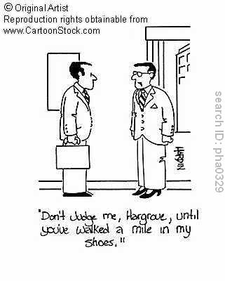
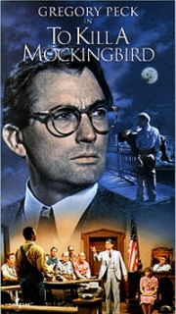
Starter What method would Atticus Finch think is the best for researching society based on the below quote?
"You never really understand a person until you consider things from his point of view - until you climb into his skin and walk around in it." spoken by Atticus Finch, To Kill a Mockingbird, by Harper Lee

Slide 2
Lesson Overview
1. know the what participant observation is
2. To know when it is appropriate to use participant observation.
3. To understand the key concepts such as verstehen, positivism and interpretivism.
A Grade – Demonstrate detailed evaluation using key terms within the 20 mark exam question .
B Grade – Provide detailed explanations of the research method within 20 marker.
C Grade – Identify different examples for participant observation.
Level of difficulty of key words used in activity
Differentiated worksheets
Writing Frames
Dictionaries
VCOP
Thesaurus
moral- consideration of the ethics surrounding covert observation.

Slide 3
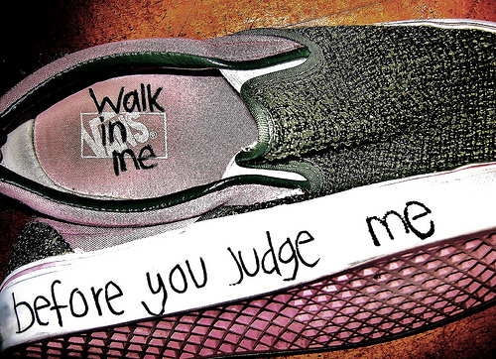
Verstehen
Weber’s term for studying human behaviour
German word for “to understand”, “to grasp by insight”
Best interpreter of human action is “someone who has been there” Someone who can understand the feelings and motivations of people they are studying- empathy

Slide 4
Some sociologists reject content analysis as they feel it lacks Verstehen
In terms of the way sociologists can study the social world, Weber argued that we should seek to take advantage of our ability to empathise with other human beings ("Verstehen" - to comprehend or understand);
We should take advantage of our ability to see the world as others see it and this involved a form of "subjective sociology" that focused on understanding the meanings and interpretations of individual social actors

Slide 5
Positivists
The aim is to be as scientific as possible. As such, positivists use questionnaires and statistics (in other words, quantitative data
Interpretivists
Sociology cannot be understood on a scientific basis. As such, qualitative methods are more appropriate, such as interviews and observation. There are also variations upon these methods (e.g. an interview can be either structured or unstructured, and observation can take place on the basis of participant or non-participant)

Slide 6
Participant Observation
An unethical research method?
Practical constraints
Weber advocated the concept of Verstehen that is where one would attempt to become closely attached to the subjects of study in an attempt to begin to understand how these individuals interpret things that are around him. One develops an “Empathy”

Slide 7
Studies …
Humphrey’s ‘Tearoom Trade’ took this type of view on researching homosexuality behaviour.
Paul Willis ‘Learning to Labour’ studied a small male group from a school. The problems with this research was gaining entry into the institution, it took six months of discussion with the headmaster before he could gain entry.
PO has it advantages and many consider it as true sociology. “As I sat and listened I learnt the answers to the questions that I would not have had the sense to ask.”

Slide 8
Participant Observation - Advantages.
Social behaviour is in it’s natural setting.
Offers the chance for small scale detailed research.
Gives validity to the meanings that actors attach to their actions.
Constructs the world according to the actor’s norms \ values \ language.
It may be used prior to a survey to establish relevant questions.

Slide 9
Participant Observation - Disadvantages.
Researcher becomes too involved and a poor observer.
As the study group is not representative generalisations are not possible. (Bothered?)
Recording information is problematic.
Is it ethical - Humphreys argued that research is unethical if :
the sociologist misrepresents their identity to gain information.
The sociologist breaks confidence.
The research has negative consequences for those being studied.
It may be physically dangerous for the observer.
It may take a long time to get in, stay in, get out.
Can a researcher ever lose their identity and study a group objectively?
The observers presence will change group dynamics + therefore behaviour.

Slide 10
Exam practice (HOMEWORK)
IN YOUR OWN WORDS!!
Examine the problems for sociologists in using participant observation. (20 marks)
Try and use key terms where possible and use the PEEL structure!!!

